Slide 1
GSBA 511: Managerial Economics
Prof. Akbulut
Chapter 15

Slide 2
Chapter 15: Outline
Monopoly
Reasons for Monopoly
Profit Maximization for Monopoly
Monopoly Power
The Social Costs of Monopoly Power
Limiting Market Power: The Antitrust Laws

Slide 3
Market Power: Monopoly and Monopsony
monopoly
Market with only one seller.
monopsony
Market with only one buyer.
market power:
Ability of a seller or buyer to affect the price of a good.

Slide 4
Reasons for Monopolies
Entry Blocked by Government Action
Patents and copyrights
Public franchises
Control of a Key Resource
Network Externalities
Natural Monopoly

Slide 5
Minimizing Costs in a Natural Monopoly
5 firms
40
35
2 firms
30
Cost per Unit (dollars)
25
1 firm
20
15
LRAC
10
5
0
10
20
30
40
50
60
70
80
90
100
110
120
Quantity of Output

Slide 6
Monopoly vs. Competition: Demand Curves
(a) A Competitive Firm
’
s Demand Curve
(b) A Monopolist
’
s Demand Curve
Price
Price
Demand
Demand
0
Quantity of Output
0
Quantity of Output
MR = P
MR ≠ P

Slide 7
Demand and Marginal Revenue Curves for Monopoly
P
LOSS IN REVENUE FROM HAVING TO LOWER THE PRICE ON ALL Q₁ UNITS = (Q₁) (ΔP/ΔQ)
P₁
P₂
GAIN IN REVENUE FROM SELLING ONE MORE UNIT = P₂
DEMAND CURVE
Q
Q₁
Q₁+1
MR < P

Slide 8
The marginal revenue curve is linear and twice as steep as the linear demand curve:
P
a
a
MR is the bisector of each horizontal line.
b
b
Demand
0
Q
c
c
Marginal Revenue

Slide 9
The Monopolist’s Profit-Maximizing Output Level
MC
6
Profits are maximized at 8 units where MR = MC
P = $4 where quantity demanded = quantity supplied
4
Price ($/unit of output)
3
2
MR
D
8
12
24
Quantity (units/week)

Slide 10
The Monopolist’s Profit- Maximizing Output Level
$/unit
ATC
MC
AVC
P*
Profit
MR=MC
D
Q
Q*
MR

Slide 11
Active Learning
Profit Maximization for Monopoly
Suppose Demand: Q = 20 – 0.4 P
Total Cost: TC = 20 + 14Q - 2 ½ Q² + 1/3 Q³
Assume this firm is maximizing profits, calculate the profit.
(Hint: Marginal Cost MC = 14 – 5Q + Q² )

Slide 12
Monopoly vs. Perfect Competition
Price
P > MC; monopoly
Marginal cost (MC)
DWL
Monopoly
price
P = MC; perfect competition and optimum
The monopolist produces less than the socially efficient quantity
Marginal
Revenue
(MR)
Demand
0
Monopoly
Efficient
Quantity
quantity
quantity

Slide 13
Social Cost of Monopoly
Price
MC
Monopoly
Price
A
DWL = B+C
Change in CS = - A - B
Change in PS = A - C
B
Competitive
Price
C
MR
Demand
0
Monopoly
Efficient
Quantity
quantity
quantity

Slide 14

A Rule of Thumb for Monopoly Pricing
We want to translate the condition that marginal revenue should equal marginal cost into a rule of thumb that can be more easily applied in practice.
To do this, we first write the expression for marginal revenue:

Slide 15

A Rule of Thumb for Monopoly Pricing
Note that the extra revenue from an incremental unit of quantity, Δ(PQ)/ΔQ, has two components:
Producing one extra unit and selling it at price P brings in revenue (1)(P) = P.
But because the firm faces a downward-sloping demand curve, producing and selling this extra unit also results in a small drop in price ΔP/ΔQ, which reduces the revenue from all units sold (i.e., a change in revenue Q[ΔP/ΔQ]).
Thus,

Slide 16



A Rule of Thumb for Monopoly Pricing
Profit maximization requires MR=MC:

Slide 17

Measuring Monopoly Power
Lerner Index:
Measure of monopoly power calculated as excess of price over marginal cost as a fraction of price.

Slide 18
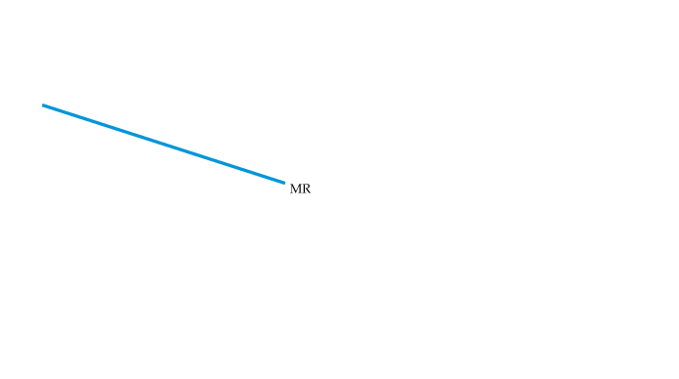

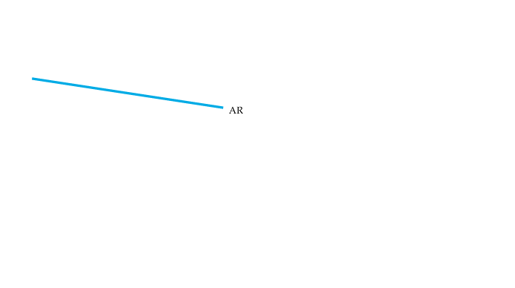
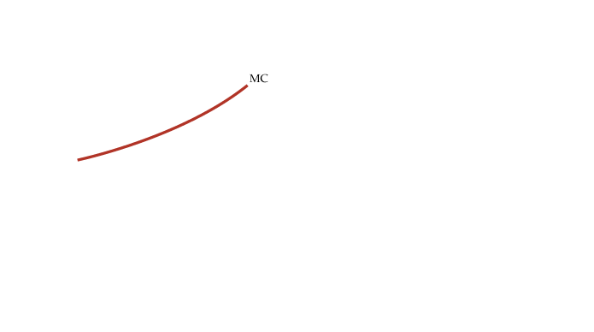
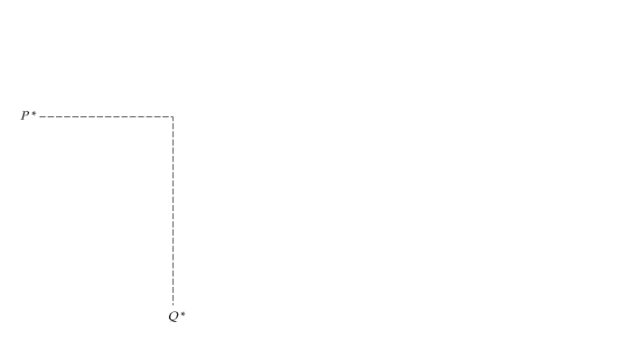
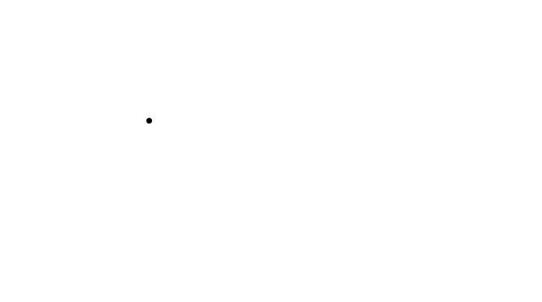
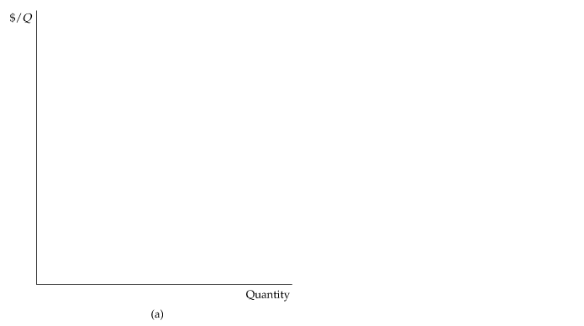
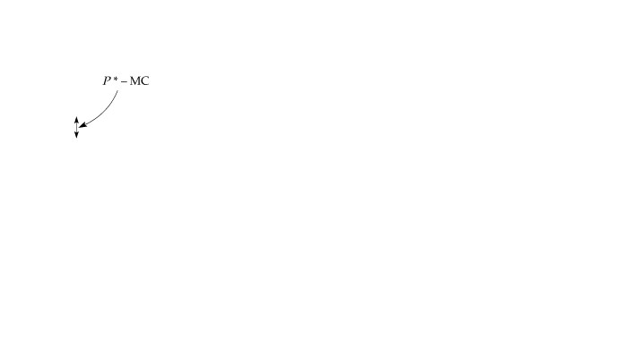
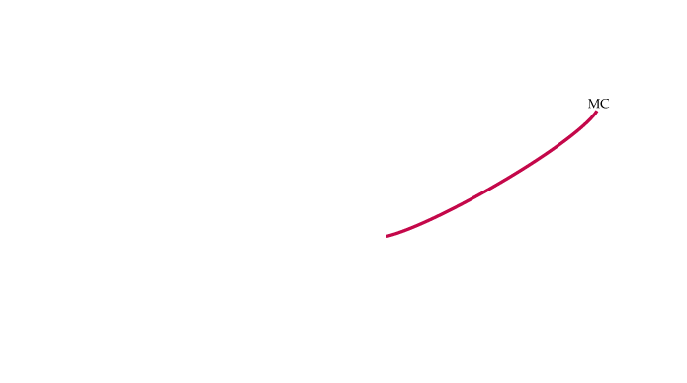
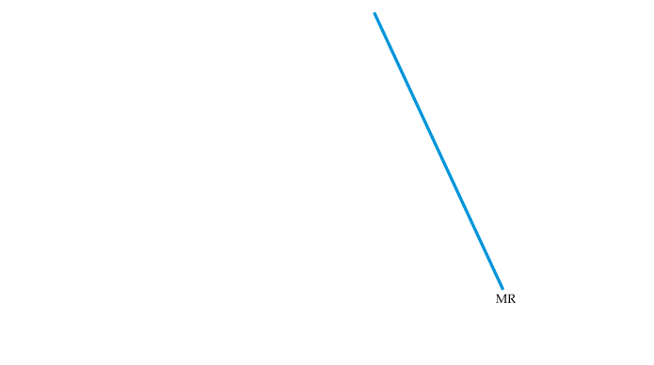
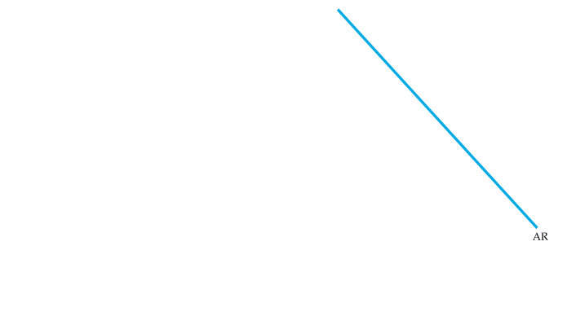
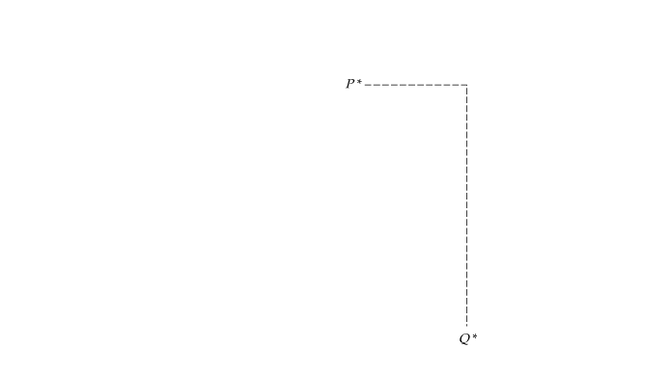
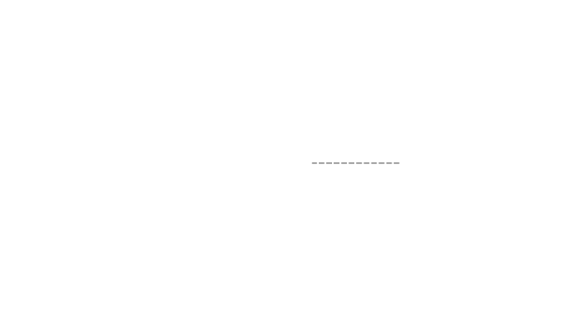

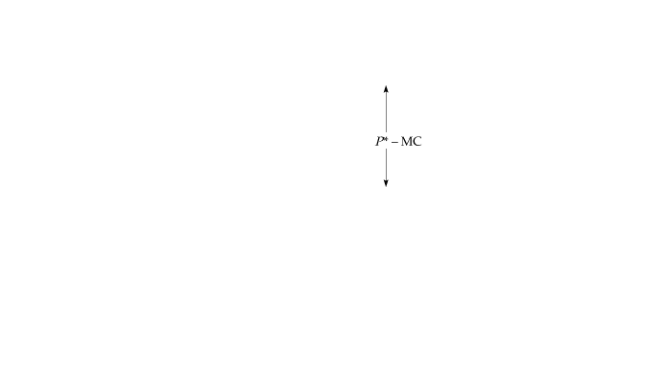
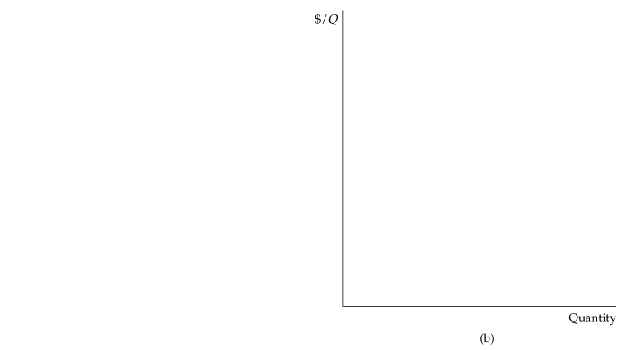
Measuring Monopoly Power
If the firm’s demand is elastic, as in (a), the markup is small and the firm has little monopoly power.
The opposite is true if demand is relatively inelastic, as in (b).

Slide 19
Public Policy towards Monopolies
Increasing competition with antitrust laws
Based on antitrust laws, the Department of Justice (DOJ) or the Federal Trade Commission (FTC) can challenge mergers, break up monopolies, fine for anticompetitive behavior.
Regulation

Slide 20
Increasing competition with antitrust laws
Sherman Act 1890
Outlawed acts, such as collusion, price-fixing, that establish a monopoly
Clayton Act 1914
Prohibited owning stock and sharing directors with competitors
FTC Act 1914:
Established Federal Trade Commission
Made some practices illegal
Cellar-Kefauver Act 1950
Prohibited mergers that significantly reduce competition

Slide 21
Anticompetitive Practices
Explicit agreement among producers to restrict output and /or fix price above competitive level
Implicit collusion:
parallel conduct
Form of implicit collusion in which one firm consistently follows actions of another.
predatory pricing
Practice of pricing to drive current competitors out of business and to discourage new entrants in a market so that a firm can enjoy higher future profits.

Slide 22
Public Policy towards Monopolies
Regulation
Govt agencies set the monopolist’s price.
natural monopoly
Firm that can produce the entire output of the market at a cost lower than what it would be if there were several firms.
At what price should the price be regulated?

Slide 23
Public Policy Toward Natural Monopolies
Price
The ideal output could be achieved by subsidizing monopoly for its loss.
Compromise outcome
Average total
cost
Average total cost
Loss
Regulated
price
Marginal cost
Ideal outcome
Demand
0
Q_{optimal}
Quantity

